Slide 1



Wrep advisory committee
MEETING #1
FEBRUARY 22, 2023

Slide 2
agenda
Introductions
2023 overview
Wrep vision evolution
Next steps
Administrative items

Slide 3
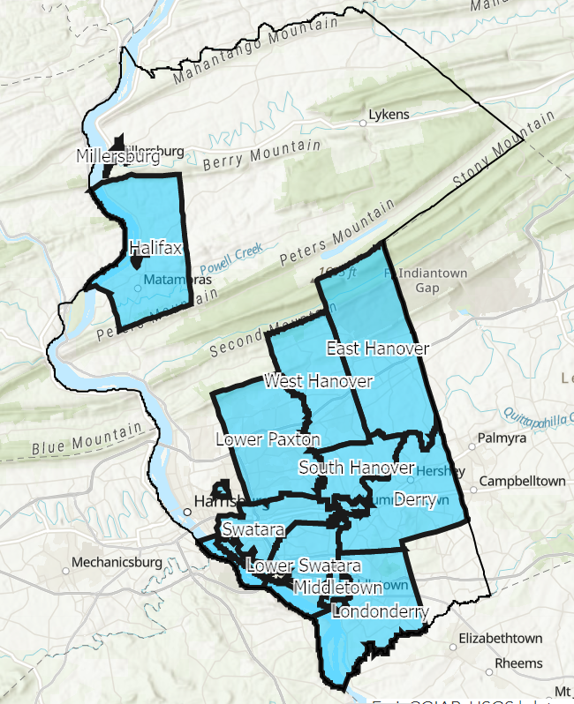
Welcome and THANK YOU!
2019
-
2023
Notes:
WREP team introductions
Municipal representative introductions
Yes, this process has taken some time, but we’re ready to go!

Slide 4
2023 OVERVIEW
Feb
April
June
March
September
December
Advisory Committee kickoff
Review current water-related goals (program and projects)
Finalize preliminary WREP goals
Review goal costs and preliminary cost share formula
Finalize program and project(s) offerings and cost share formula
Elected officials (County and local) approval of program
Prepare for 2024 implementation
Review the CAP
Finalize CAP request

Slide 5
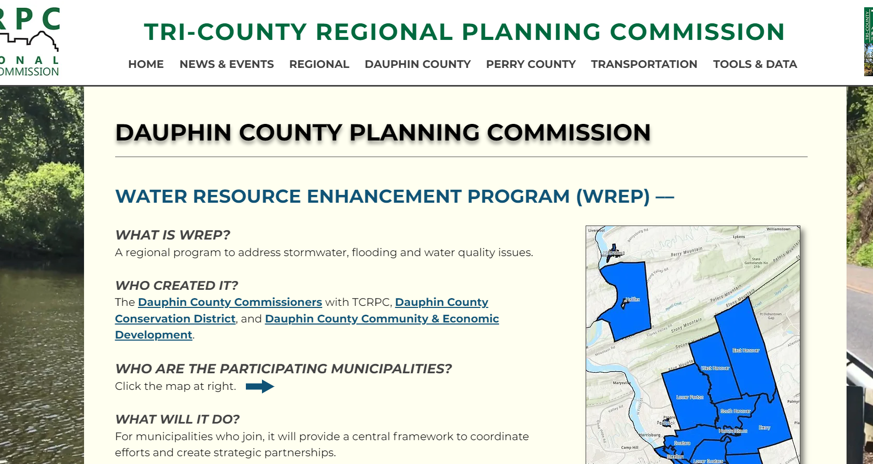
DCPC Website - resources
https://www.tcrpc-pa.org/dcpc-wrep

Slide 6
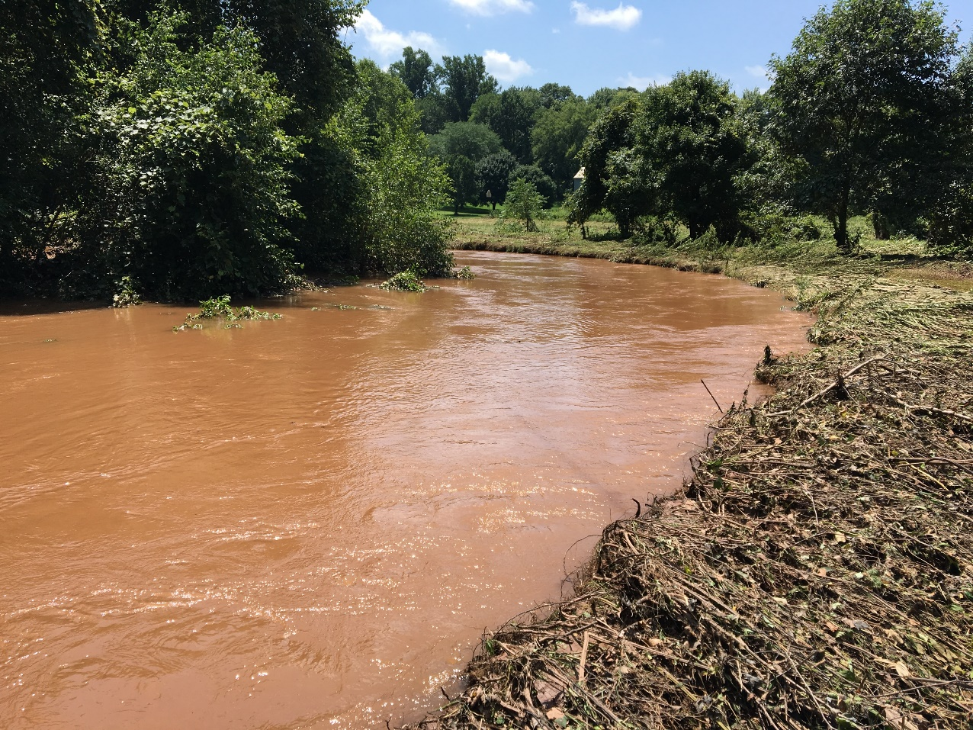
WREP VISION
2019-2022
Armstrong Creek, 2018 (DCCD)
Notes:
At the time that we started this process, most of our thoughts went to mitigating the causes of streams looking like this after a rain storm.
We’ll refresh your memory with respect to how WREP developed and start to outline how it will need to evolve.

Slide 7
Regional Water resource improvements
CAP Block Grant
2022: $650,000
2023: $225,000
2024: ?

Slide 8

WREP GOALS
GOALS
Cheaper MS4 Permit compliance
Enhanced grant funding cooperation
Reduce localized flooding frequency/intensity
Preparedness for next MS4 permit term and other Chesapeake Bay goals for Dauphin County
Have a better educated public on stormwater issues and opportunities
Provide more resources to farmers to update plans and install BMPs
Integrate MS4 and farming water quality goals
County-wide data integration

Slide 9
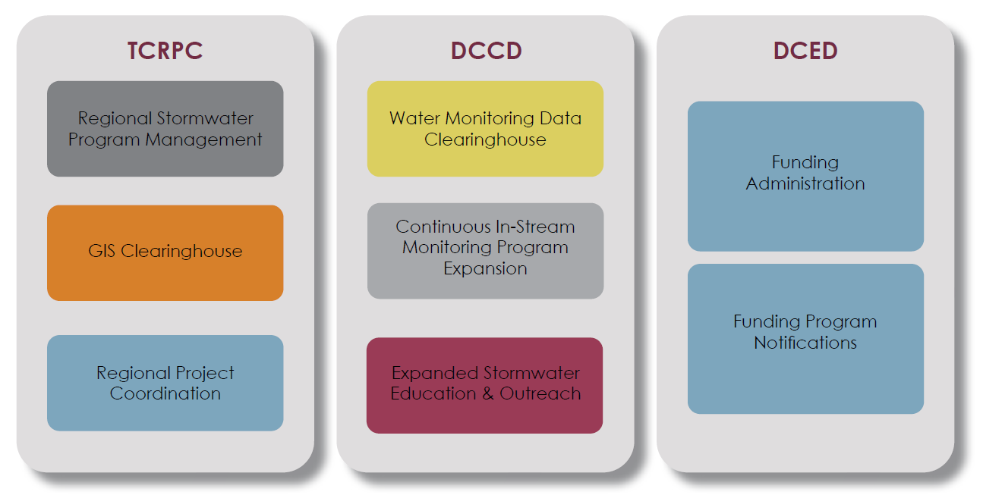
WREP ROLES
Dauphin County Commissioners
WREP Advisory Committee

Slide 10
Evolving water resource variables
What has changed for your organization since 2019?
  MS4
  Infrastructure funding
  Staff
  Stormwater fees
  Elected officials

Slide 11
2019 poll question:
In which areas could your municipality use more support for water resources needs or goals?

Slide 12
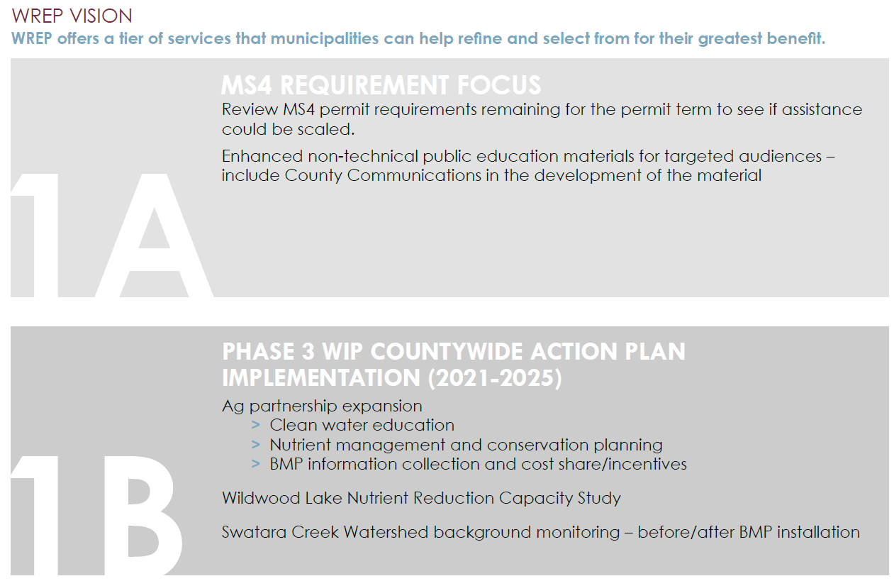

Slide 13
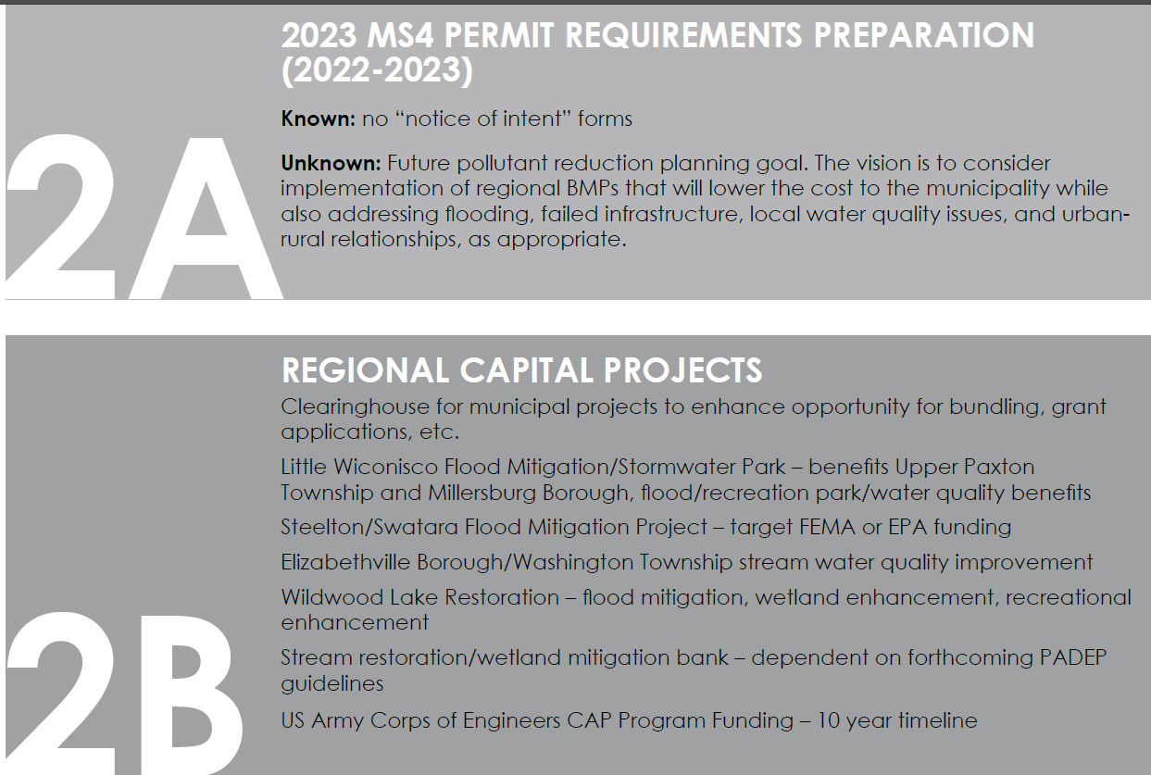
2024/2025

Slide 14
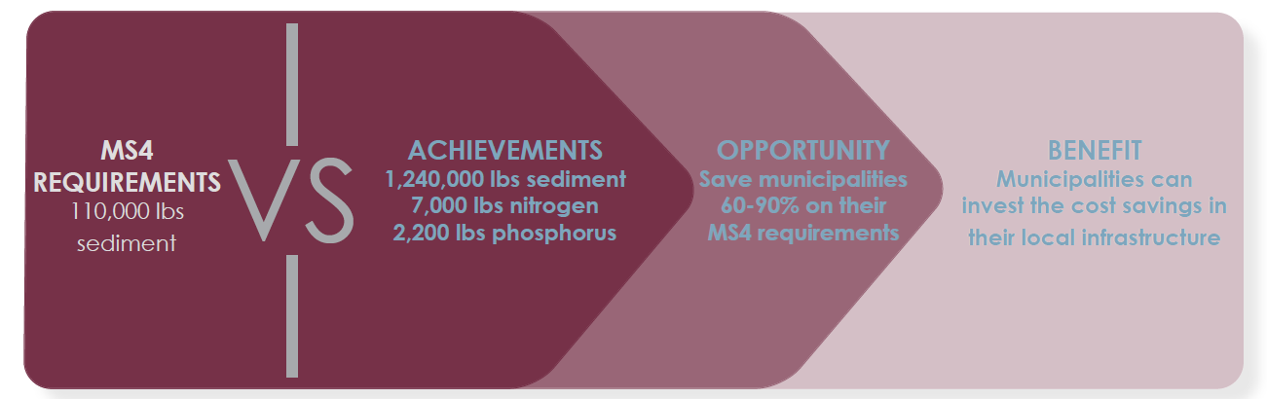
WREP PROJECT 1
Conewago creek stream restoration
Notes:
When our team provided County leadership about WREP, they asked for a project example to help describe the vision for the regional program. We spoke with some of the Advisory Committee members about their existing projects in case there were some minor changes that could be made to make them more regional in nature – expand scope upstream, bundle projects for construction, etc. We also knew of a few projects that may have yielded more sediment reduction credits for MS4 than the home municipality needed. That’s what lead us to identifying WREP Project 1.
We worked with DEP to demonstrate the watershed connection between these two HUC-12s, enabling municipalities within these two watersheds to collaborate on implementing the Conewage Creek Stream Restoration project.

Slide 15
Wrep project 1
Conewago creek stream restoration
  CAP Block Grant requirements
    Shovel ready
    High water quality benefits – sediment and nitrogen
  WREP co-benefits
    Regional benefits – MS4, multi-county
    Recreation
    Publicly accessible
    Future phases planned
    Initial funding secured
    Site monitoring
https://storymaps.arcgis.com/stories/c3a1e7e257f54ad59b237e1d40417fa9
Notes:
We had limited funding in our CAP Block Grant in 2022, but the available funding was enough to contribute to a phase of work that could be built in 2022. The project also yields high nitrogen reductions because its watershed is rural, which is a priority for CAP goals.
This project is special because of the almost 20 years' worth of planning, fundraising, and partnership development that Londonderry Township had completed. Project 2 (or 3) might not have all of these co-benefits, but these are examples of the other benefits that a WREP project might result in.

Slide 16
WREP VISION
2023 AND BEYOND
Notes:
We can have a blank slate or we can work from the vision that we developed based on the feedback we received in 2019-2020 – it’s up to this group to decide on the direction that WREP goes

Slide 17
2025 MS4 PERMIT
KnownS
  2018 PAG-13 extended to March 15, 2025
  2018 PRP implementation deadline – Summer 2023
  2025 PAG-13 – no Notice of Intent to apply
  unKnownS
  Draft 2025 permit
    End of 2023 release for public comment?
    Submittal deadline Sept. 2024?
  Future sediment reduction requirements and preferred project types
Notes:
PRP implementation deadline – varies by municipality, but generally summer 2023 for General permittees. Individual permittees likely have more time because their permits were issued after the General permit approvals.
Guesses on the next permit based on experience from 2018 permit release – new permit was released 1 year before applications were due, applications were due 6 months before permit started
What we do know is that it will be good to have this group already collaborating in advance of the next permit so we can work through challenges together.

Slide 18
Regional focus
Notes:
The original vision was developed based on county-wide needs. A new regional vision will be developed based upon the Founding Municipalities’ advisory committee participation in these discussions.

Slide 19
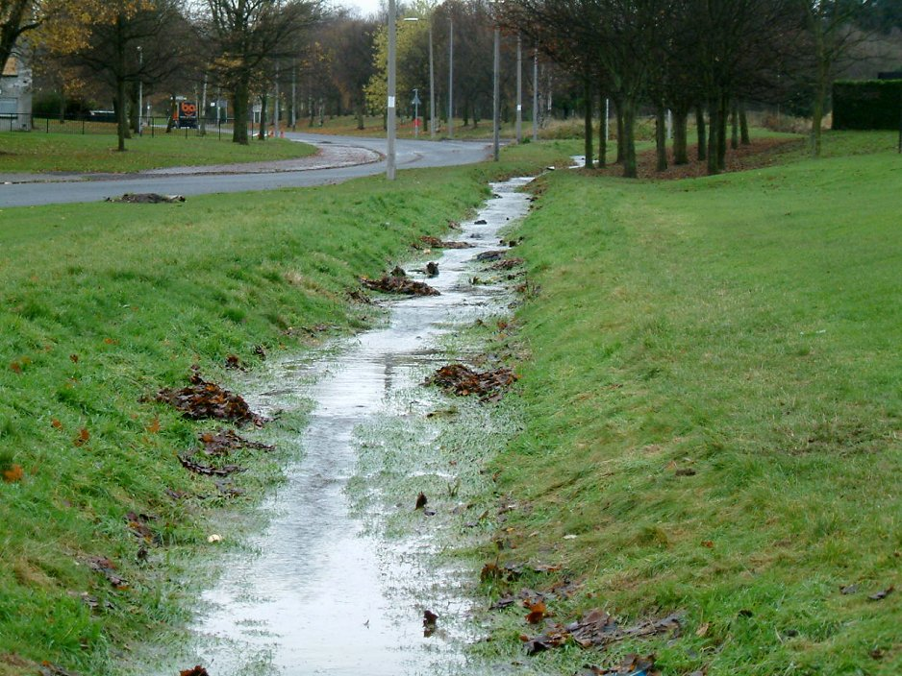
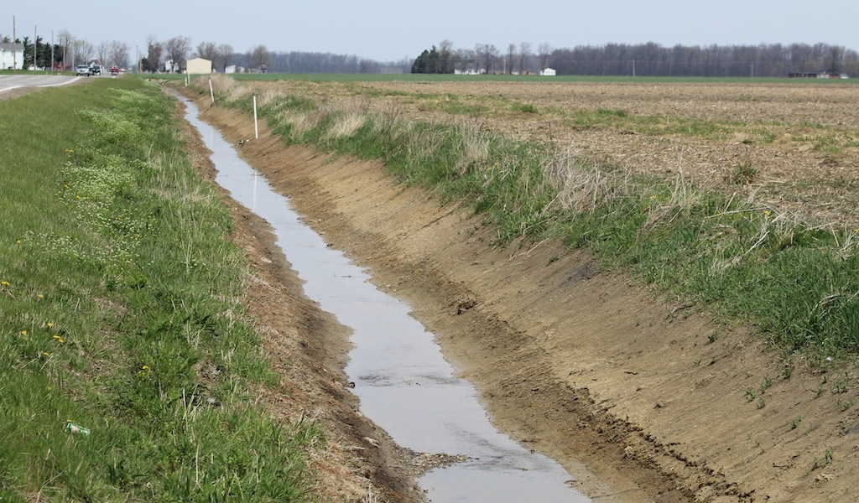
Think beyond urban stormwater challenges
Notes:
Urban and agricultural stormwater challenges are not always that different. It’s time to think beyond meeting regulatory requirements for MS4.

Slide 20
Program vs. project
Program examples
  Enhanced public education
  MCM mentorship
  Environmental monitoring program
  Project examples
  Structural BMP
  Flood mitigation project
  Regional plan
Notes:
Need to have some definition for program elements versus projects due to how costs may be covered in the future. Program elements likely will be paid for among the entire group or in a tier of services. Projects will likely be paid for by only the individual participants who directly benefit from the project – like the Conewago Creek project.

Slide 21
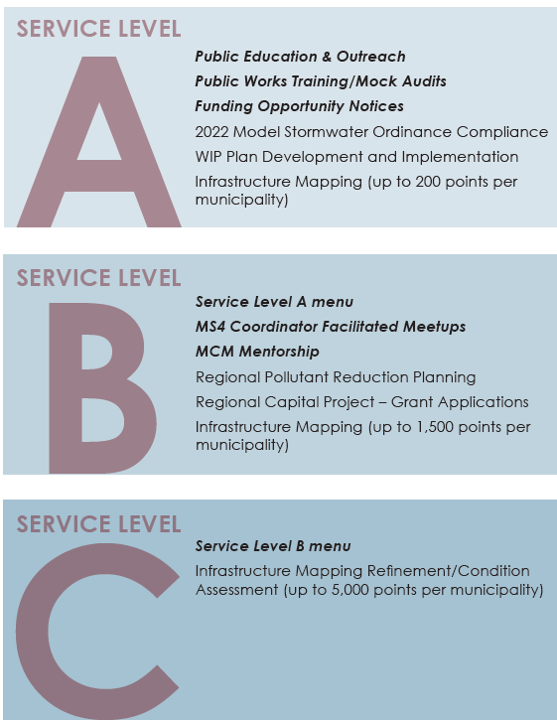
Tiered program example

Slide 22
Next Steps
Review our existing information about your organization
  Infrastructure project needs – locations, budgets, scopes
  Has anything changed?
  Any regional project ideas?
Respond to our poll
  Vote on priorities reviewed in 2019
Bonus points – familiarize yourself with the cap
  https://countywide-action-plan-dauphinco.hub.arcgis.com/

Slide 23
ADMINISTRATIVE ITEMS
pAPERWORK
  Signed agreements
  Invoice payments
Municipal representative
  Primary
  Alternate

Slide 24
Administrative next steps
Ground rules
  Active participation
    Primary representative
    Stakeholder comments
  Meetings – 1pm
    Location – consistent or variable?
    Format – in person only or hybrid?
    Monthly at first, transition to quarterly
    Separate project-specific meetings
  Member voting
  Non-Dauphin County member role
  Interest in bylaws/formal procedures?
  Who receives emailed communications?
  Online platform?
    Teams channel, Google folder, website log-in
Notes:
Provide comment sheets for stakeholders who want to provide feedback on agenda items

Slide 25
REPEAT 2023 CALENDAR

